Slide 1
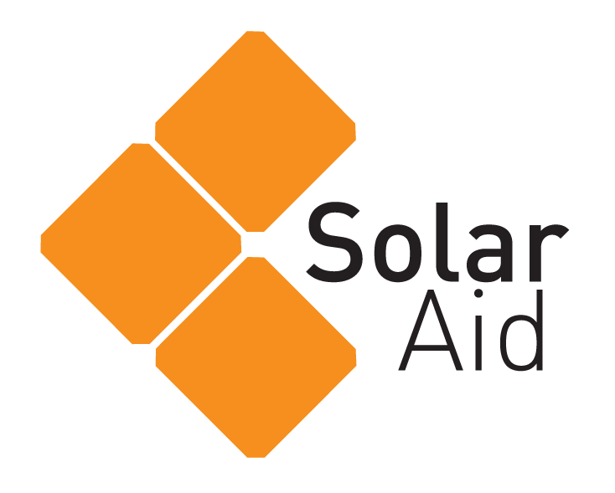
SolarAid Bringing light to rural Africa
Notes:
SolarAid and SunnyMoney work together to bring solar lights to the most rural parts of Africa. 598 million people in Africa alone have no access to electricity. Without electricity families have no clean source of light, leaving millions to rely on expensive and dangerous alternatives. Many use homemade kerosene lamps which are a poor source of light; they emit toxic black smoke, eat up to 15% of a family’s income and are extremely hazardous. Children can’t study at night, the working day ends prematurely and indoor air pollution presents a serious health hazard.
This video is fantastic for showcasing what SolarAid does: https://www.youtube.com/watch?v=YmwQEIPV2Y8 (hyperlink on slide)

Slide 2
90%
in the dark
of Africa’s rural population are
SolarAid’s BHAG (Big Hairy Audacious Goal) is to eradicate the kerosene lamp from Africa by 2020
Notes:
SolarAid aims to eradicate the kerosene lamp by bringing solar light to millions of people in rural parts of Africa.
They have a BHAG (Big Hairy Audacious Goal) to help them do this. It helps them to keep a clear focus of the work that needs to be done.

Slide 3
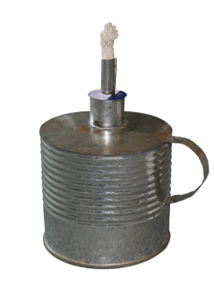
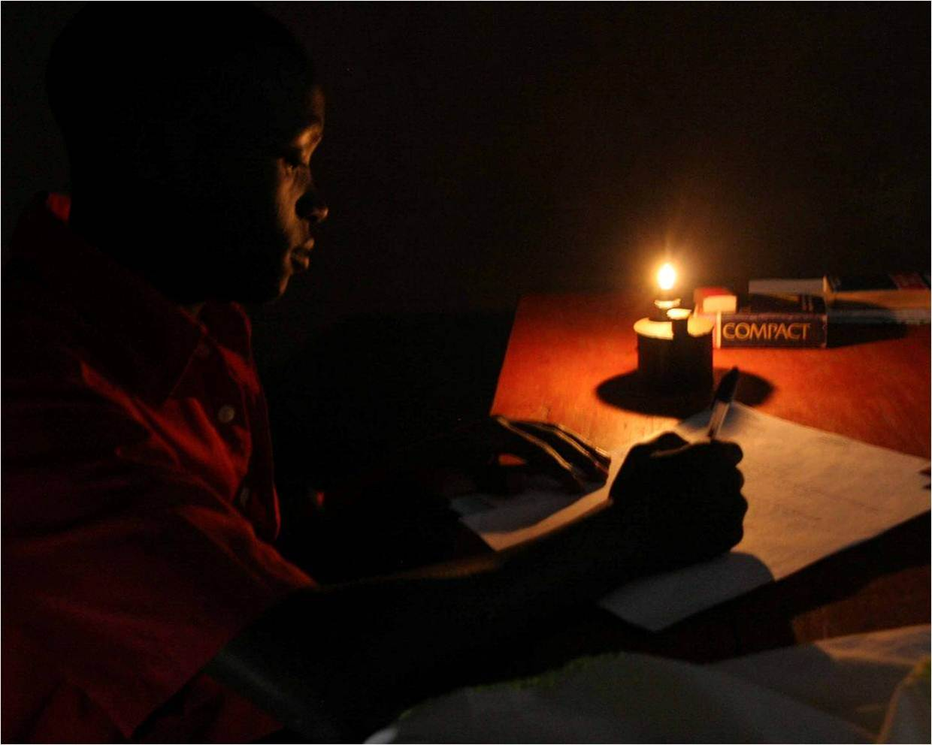
What’s happening now
Millions use kerosene for light. This is bad because:
Expensive
Bad for health
Dangerous
Emits black carbon
Does not promote education
Notes:
People spend on average 15% of their annual income on kerosene for light
More people get seriously ill or have accidents from indoor air pollution than malaria.
Kerosene does not allow for students to study in safety after 6pm. Countries near equator get dark by 6pm.

Slide 4
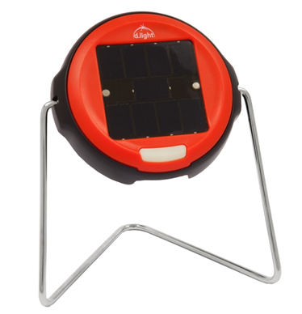
How a solar light can change this
With a solar light SolarAid can change people’s lives.
Children can study an extra hour each day
Parents spend the annual savings of $70 on food, education and business
Health is improved and life is safer
CO2 emissions are reduced
Notes:
Each solar light that gets into the hands of one family, changes the lives of 4 people.
Solar light customers tell us that investing in a solar light saves money, improves health, makes their homes safer and helps children study at night.
Each solar light shining also means one less kerosene lamp, saving around 200kg of carbon dioxide per year.

Slide 5
Look at how we work
In the UK SolarAid fundraise
In Africa SunnyMoney sell lights
Notes:
We operate both as a charity and a social enterprise. We fundraise through the charity SolarAid and sell and distribute solar lights through SunnyMoney.
We need money to get to the rural areas and set up a sustainable market for a product that isn’t widely available.

Slide 6
The SunnyMoney Way
SolarAid does not give things away like traditional forms of aid
SolarAid is working to build a sustainable market for solar lights so that SunnyMoney can continue to exist on it’s own.
This framework also creates jobs and business opportunities
SolarAid is product neutral: this is to ensure that our customers get the highest quality solar lights on the market
Challenges:
Trust
Access
Affordability
Notes:
We believe that universal access to renewable energy is the best way to alleviate poverty. And the best way to ensure universal access is through a unique mix of business and innovation.
So in 2006 we set-up a social enterprise, SunnyMoney, who are now the leading seller of solar lights in Africa. SunnyMoney are selling lights fast, they are helping build sustainable markets, they are creating jobs and they are ensuring money stays in the local economy. To put it simply, they are the reason why we have created a brave and ambitious goal; to eradicate the kerosene lamp from Africa by 2020.
But that’s only part of the picture. We’re also helping to create innovative solutions such as pay-as-you-go solar, we’re undertaking large-scale research projects and sharing our knowledge and expertise with partners and like-minded organisations. We know we can’t eradicate the kerosene lamp on our own; so we’re building an alliance, we’re creating a movement.

Slide 7
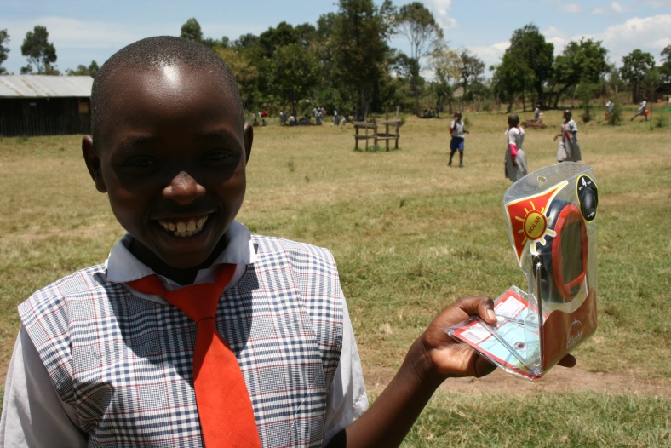
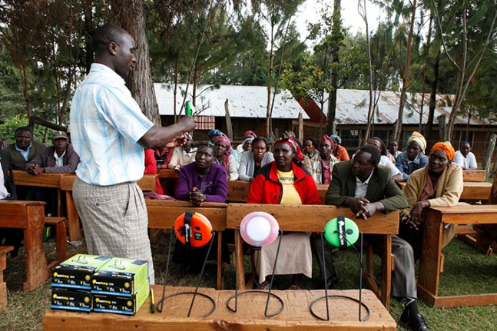
School Campaigns
We work with Head Teachers so that they can introduce solar lights to their schools in rural areas of Africa.
Notes:
SunnyMoney’s unique community distribution model uses teachers to raise trust and build awareness of solar. Each light shining in the night attracts neighbours and as word spreads the demand for solar lights grows.

Slide 8
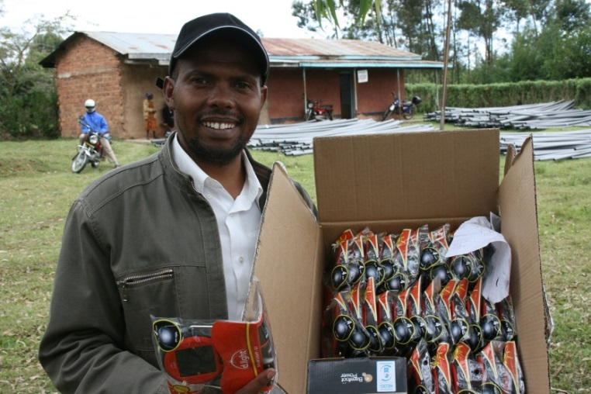
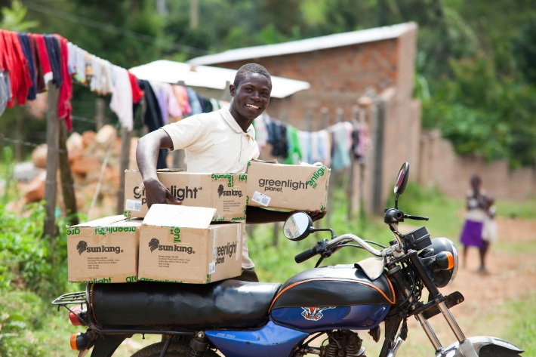
Research and Innovation
Agent Networks
SolarAid also distribute solar lights through entrepreneurs – people we call agents. This is great because they:
Create jobs in local communities
Get SolarAid in more and more remote areas
Encourage passionate solar people to help promote lights
Notes:
This sparks the market conditions required for local shops and independent agents to be able to sell a range of solar lights profitably within their community so that solar lights become available for people to purchase all year round. SunnyMoney supports these local entrepreneurs by providing marketing campaigns, training and shipping of products.

Slide 9
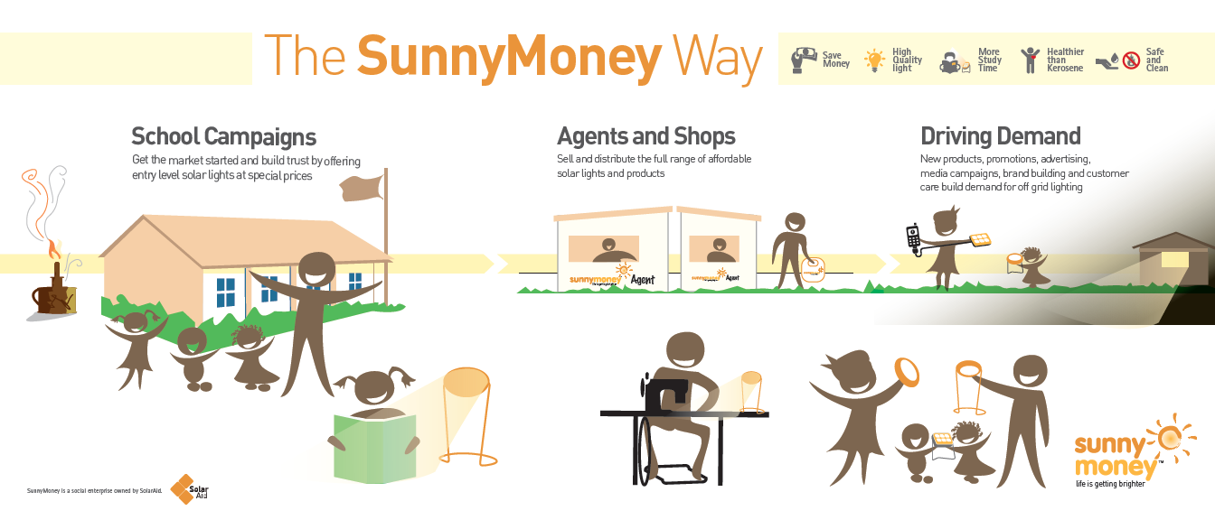
Appropriate Funding
Notes:
SunnyMoney continues to find ways to drive demand by creating brand awareness, community engagement and media attention. They run promotions and find ways to market new products cost effectively in order to make solar more affordable and meet customers’ increasing demand for bigger and better products, so the market continues to thrive.

Slide 10
SunnyMoney have sold over 1.7 million solar lights and will work with partners to reach the whole of Africa!
Notes:
The impact of selling 1.7 million solar lights is just remarkable in Africa. Look at the statistics! You can help to Light the Way
SolarAid is calling for everyone, young, old, rich, poor - from the CEOs of multinationals to school children in Africa - to join the solar movement. Everyone can play a part in a cleaner future.
From our customers in Africa creating demand through word of mouth, to our amazing supporters spreading news of our work via social media. This is a movement we can all get involved in.
GIIRS Ratings are the gold standard for impact measurement in impact investing. They are rigorous, comprehensive, and comparable ratings of a company or a fund's social and environmental impact.

Slide 11
We are leading the way for others to join in – look at the countries SunnyMoney works in already
Notes:
SunnyMoney works in Kenya, Malawi, Tanzania, Zambia and has recently moved into Uganda.

Slide 12
THANK YOU
Notes:
SolarAid made this video to say thank you to all those who helped us reach a million solar lights in Africa: https://www.youtube.com/watch?v=1rjZGcEnMDU
Though we have now reached 1.7 million we still love this video

